Slide 1


A Reinforcement Learning approach to Computer Vision problems
Rayan Samy Ramoul
AI Engineer
17/10/2023

Slide 2
PLAN
01.
04.
02.
05.
03.
06.
Applications
Why RL for CV
Reminders on RL
Observations & Challenges
Deep RL
Recent Advances

Slide 3
01.
Why Reinforcement Learning for CV?

Slide 4



Why Reinforcement Learning for Computer Vision ?
Reinforcement learning augments the reinforcement learning framework and utilizes the powerful representation of deep neural networks.
RL demonstrated remarkable successes in various domains including finance, healthcare, games, robotics, and computer vision.
Reinforcement performs well in other problematics. Would it work on Computer Vision ?
1/42

Slide 5
02.
Reminders on RL

Slide 6
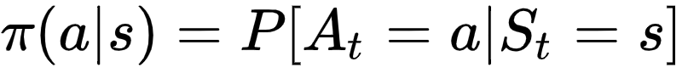
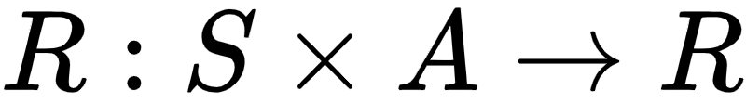
Foundations of reinforcement learning : Markov Decision Process
Environnement
Actions
Probabilities of transitions and “policy”
Set of finite states S
Finite set of actions A
Reward
Return expectation
Value function
2/42

Slide 7
And then ?
When faced with the challenge of processing complex image data, traditional methods, including Reinforcement Learning (RL), often struggle to extract meaningful features, necessitating the integration of Deep Reinforcement Learning (DRL) to effectively navigate and make decisions in image-rich environments, as demonstrated in tasks such as autonomous driving and medical image analysis.
3/42
17/26

Slide 8
03.
Deep RL

Slide 9
Deep Reinforcement Learning
Deep RL = Reinforcement Learning + Deep neural networks.
It enables agents to learn complex behaviors and make decisions in high-dimensional state spaces. Deep RL has gained immense popularity due to its success in solving a wide range of challenging tasks.
4/42

Slide 10
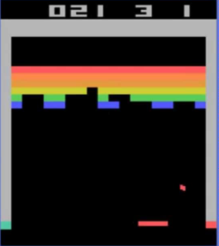
Deep-Q-Learning (a DeepMind algorithm)
P = 0.489
Q value Estimator
Conv3-32
Output
( softmax)
Conv3-32
Conv3-32
Conv3-32
Max-Pool
Conv3-64
Max-Pool
Conv3-128
Max-Pool
Conv3-64
FC-512
Neural network called "Q-Network" with convolutional layers for feature extraction and fully connected layers with softmax output
P = 0.511
Environmental state representation
Network output after softmax: probability that each action is the best possible.
5/42

Slide 11
04.
Applications
Object Localization
Object Tracking
Landmark Detection
Image Segmentation
Image Registration
Video Analysis

Slide 12
Object Localization

Slide 13
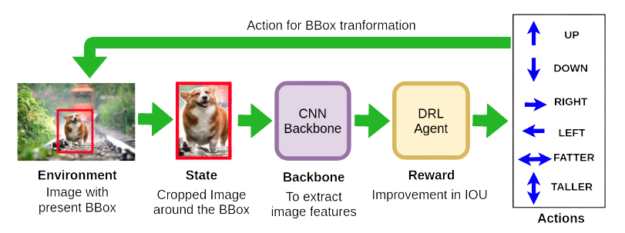
Object Localization
Active Object Localization with Deep Reinforcement Learning
Use of the Replay-Memory algorithm (history sampling, periodic duplication of the q-network).
Expert agent to optimize exploration during learning.
Hyper-parameterization decisive for model efficiency.
6/42
17/26

Slide 14
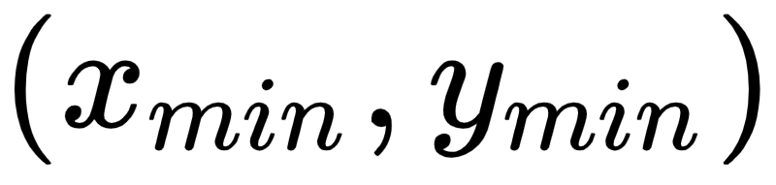
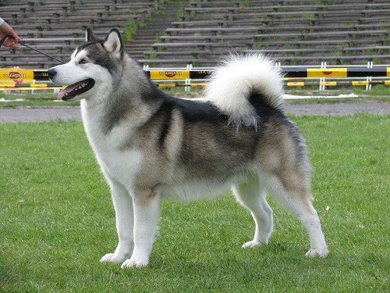
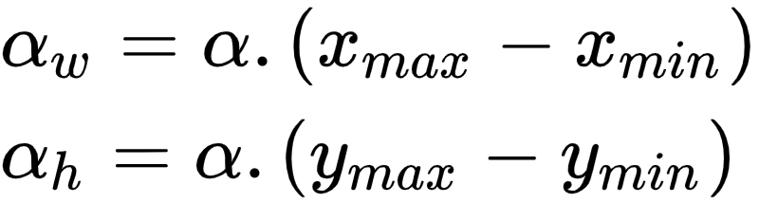






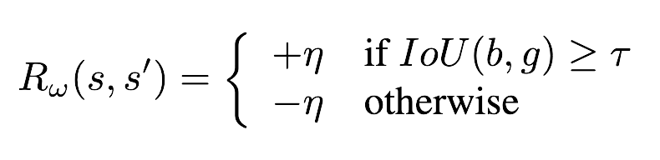


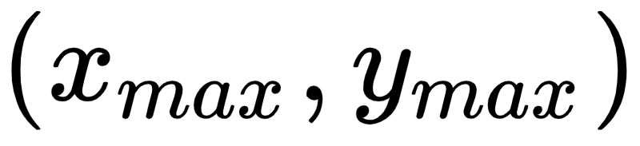
Environnement : Bounding Box
Actions : translations of bounding box
Datasets used :
Pascal VOC 2007 + 2012
Rewards
7/42

Slide 15
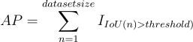
Evaluation Metric for the Reward
Truth
Intersection
Prediction
+1, If IoU > threshold
-1 else
Truth
Union
Prediction
8/42

Slide 16
Features Extraction
Resize
Feature
Vector
History of 9 previous actions in one-hot
001000000
000010000
100000000
.
.
.
000100000
000100000
000000100
Convolutional Neural Network with frozen weights
Action 1
Action 2
X
Action 3
Max ( output ) = chosen action
The collected rewards are backpropagated through the network.
Feature
Vector
Action 9
X (81+25088)
Layer 1 (1024)
Layer 2 (1024)
Output Layer (9)
9/42

Slide 17
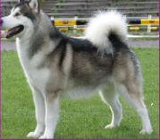
Feature
Vector
History of actions in one-hot format
001000000
000010000
100000000
.
.
.
000100000
000100000
000000100
Stopping at :
Or after 40 iterations.
X
Feature
Vector
End-to-End Process
10/42

Slide 18
A network per class
Dog’s Q-Network
Feature
Vector
Person’s Q-Network
N.B : n-class = n-networks trained on each
11/42

Slide 19
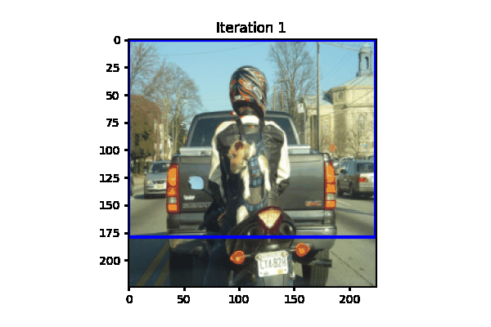
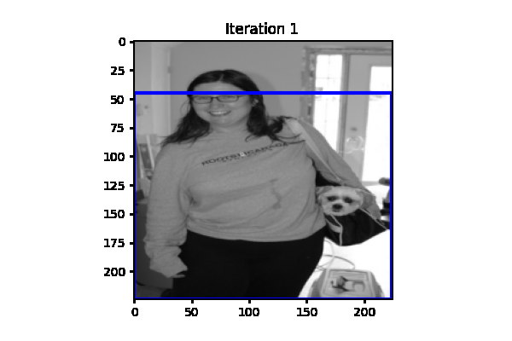
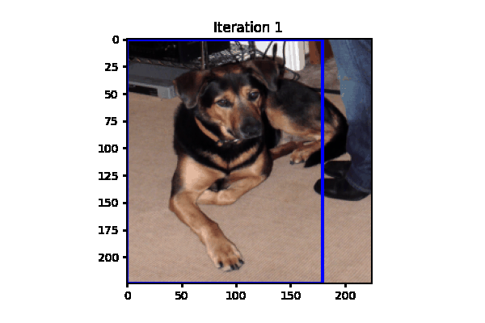
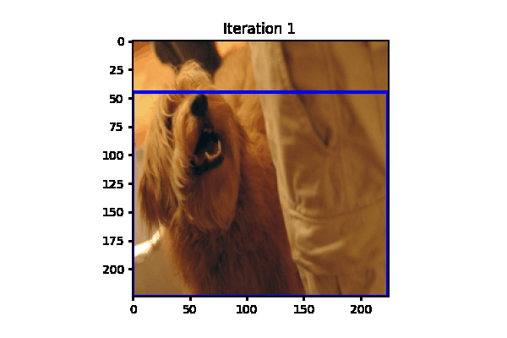
Benchmark vs State-of-the-art (at time)
Improvements
Speed of inference.
Processing of images with occlusion and truncation.
Better in performance than approaches without object proposal.
Disadvantages
1 to 2% less accurate globally than Faster RCNN.
12/42

Slide 20
Object Tracking

Slide 21
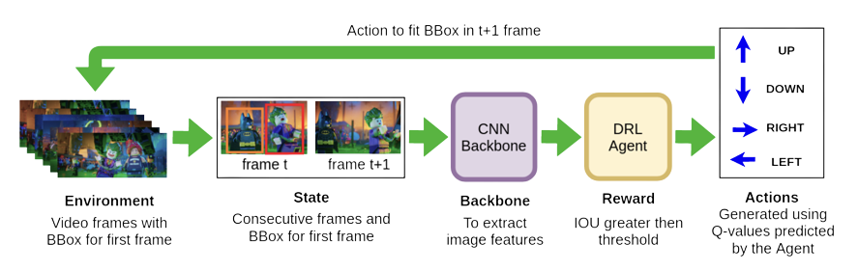
Object Tracking
Multi-agent deep reinforcement learning for multi-object tracker
Object tracking in computer vision is the process of continuously locating and following objects in video sequences, often involving object detection, feature extraction, and motion prediction. It is used in applications like surveillance, autonomous vehicles, and robotics to monitor and interact with objects in real-time.
Using two consecutive frames (Ft, Ft+1) and a bounding box the agent adjust the bounding box to fit the object in frame Ft+1.
13/42
17/26

Slide 22
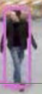
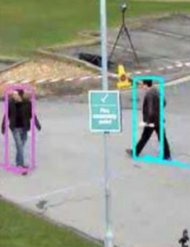
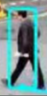
Object Tracking
First Frame of the video
Agent 1
Numbers of objects: 2
Agent 2
Object Localization using YOLO
Create an agent associated to each bounding box
14/42

Slide 23
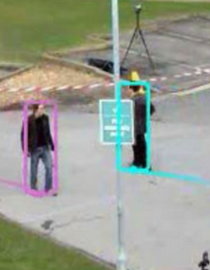
Feature
Vector
A 1
Bounding Box from F_t-1
A 2
X
chosen action
A 3
Feature
Vector
A 9
State Representation
Frame F_t
For each agent
For each frame F_t
15/42

Slide 24
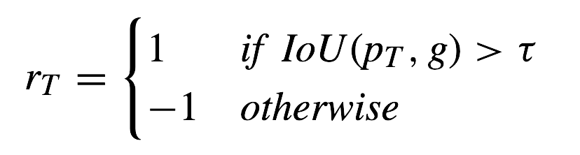




Actions : translations of the bounding box
Right
Up
Left
Down
Rewards
Scale Up
Scale Down
Fatter
Taller
Based on IOU (Intersection over Union) exceeding a specified threshold.
Stop
16/42

Slide 25
Benchmark vs State-of-the-art (at time)
Improvements
Disadvantages
Speed of inference.
Powered by YOLOv3 effectiveness.
Better performance in robustness.
Top 2 in mAP globally
17/42

Slide 26
Landmark Detection

Slide 27
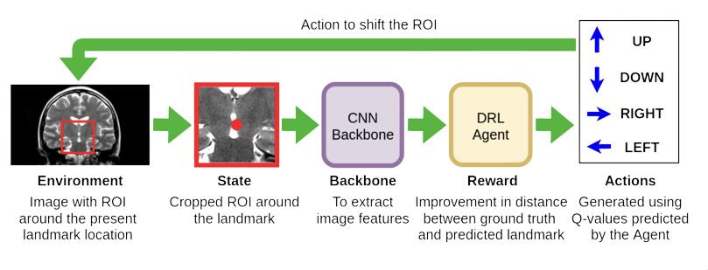
Landmark Detection
Multi-scale deep reinforcement learning for real-time 3d-landmark detection in ct scans
Landmark detection involves the localization of an object within a 3D acquisition, such as in the case of CT scans.
Using the region of Interest (ROI) centered around the current landmark location cropped from the image the agent shifts the ROI across the image, forming a new state.
18/42
17/26

Slide 28
Rewards
Distance-based feedback, which is positive if the agent gets closer to the target structure and negative otherwise.
Environnement
Actions : moves of 3D box
3D system re-center on voxel position
Up
Back
Right
(0, 0, 0)
Left
Down
19/42

Slide 29
Benchmark vs State-of-the-art (at time)
Improvements
Disadvantages
Achieves a 0% failure rate on all considered landmarks and improves the average accuracy of reference methods by 20-30%.
Speed of algorithm is 2-3 orders of magnitude faster, reaching real-time performance on high-resolution 3D-CT volumes
Robust against outliers
Difficulties with absent objects.
Difficulties with detection of multiple objects.
20/42

Slide 30
Image Segmentation

Slide 31
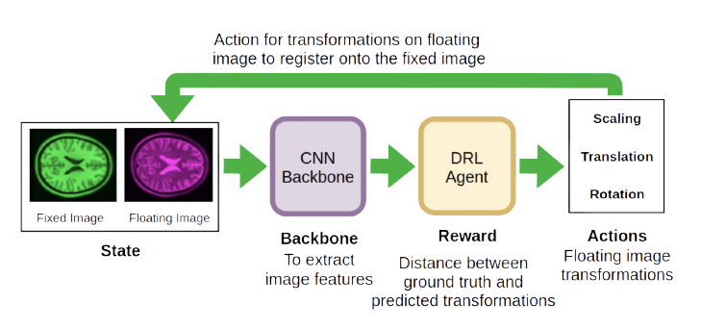
SeedNet
Seednet: Automatic seed generation with deep reinforcement learning for robust interactive segmentation
In a medical context, image segmentation refers to the process of partitioning a medical image, such as an MRI or CT scan, into specific regions or structures, enabling precise identification and analysis of anatomical or pathological features. This technique is essential for tasks like organ delineation, tumor localization, and disease assessment in healthcare.
Early work in medical image segmentation using Q-Matrix.
The image and the segmentation mask are the input of the DQN. The seed set is updated
Using the newly created seed from the DQN, and the mask is generated using the revised seed set. The obtained mask is used to calculate
21/42
17/26

Slide 32
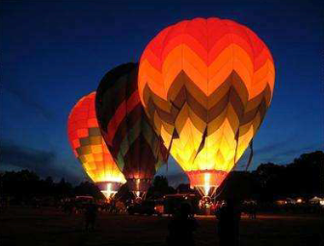

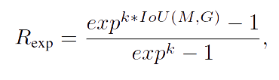
Environnement
Actions : Seed point
Original Image + Segmentation Result
Action : is defined as a positioning new seed point.
The agent decides the label (foreground/background) and position of the seed in the 2D grid given the states.
Transform image to bigger grid to reduce action space.
Rewards
Using the accuracy of the segmentation mask as a score concept. the reward value by comparing with the GT mask, and this process is repeated.
22/42

Slide 33


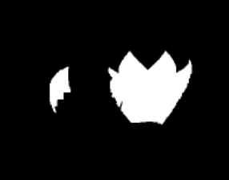

SeedNet
Q-Network
Seed Generation
Seed Update
Image
Segmentation
Seed
Reward
Observation Update
Ground Truth
New Segmentation
Compute Reward
23/42
17/26

Slide 34
Benchmark vs State-of-the-art (at time)
Improvements
Disadvantages
Achieved improved results compared to initial seed points.
Best seed generation algorithm (to prepare for next segmentation algorithms)
Compared with supervised methods (FCN and iFCN) and outperformed them.
Improved ratio pixel-wise labeling / computation.
Weaknesses on some specific datasets (lack of generalization).
24/42

Slide 35
Image Registration

Slide 36
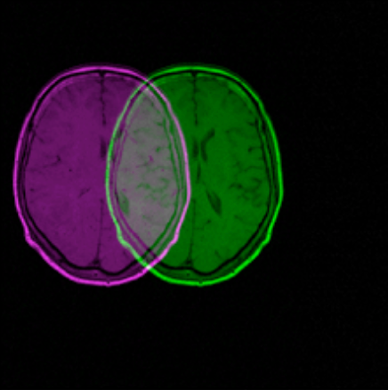
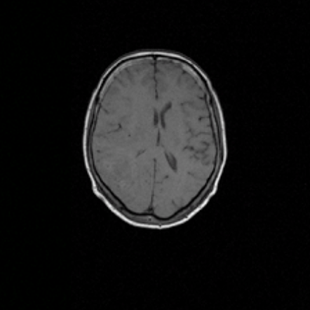
Image Registration
Robust multimodal image registration using deep recurrent reinforcement learning
Image registration is a basic yet important pre-process in many applications such as remote sensing, computer-assisted surgery and medical image analysis and processing.
In the context of brain registration, for instance, accurate alignment of the brain boundary and corresponding structures inside the brain such as hippocampus are crucial for monitoring brain cancer development
Registration
25/42
17/26

Slide 37
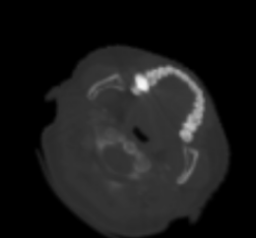
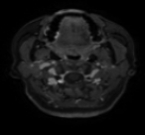
Environnement
Actions : Rotations/Translations
Fixed Image + Image to Register
The set of actions comprises all the rotation and resizing operations that can be performed on the object within the image.
t_x + 1
s - 0.05
t_y + 1
alpha - 1
t_x - 1
alpha + 1
t_y - 1
s + 0.05
26/42

Slide 38
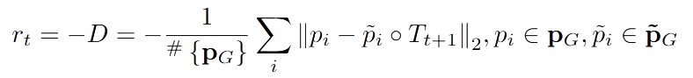
Rewards
The Euclidean distance D between the transformed landmarks and the corresponding ground truth is used to define the reward for action.
Where pi and ˜pi are the landmark points, ◦ denotes the align operator, # {} calculates the number of points. In addition, if D is smaller than a threshold, we assume that the terminal is triggered, and a terminal reward is set in this situation.
27/42

Slide 39
Benchmark vs State-of-the-art (at time)
Improvements
Disadvantages
Best performance at time.
Results indicated that RL with all three components contribute to the method's performance.
Weak scalability to 3D image registration in cases of high dimensionality.
Huge impact/sensitivity of reward function can have a significant impact on the method performance.
No benchmark on images with large deformations.
28/42

Slide 40
Video Analysis

Slide 41
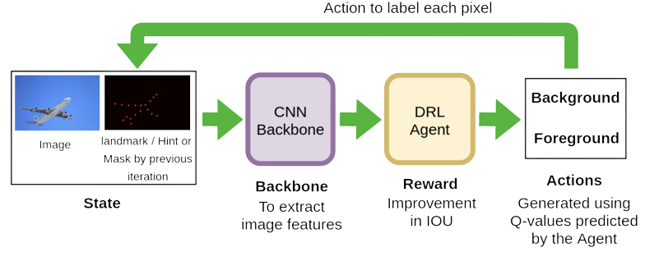
Video object segmentation
Reinforcement Cutting Agent Learning
Video Object Segmentation: It's a challenging computer vision task involving the segmentation of objects in video sequences.
Complexity: Segmenting objects in videos is complex due to the continuous decision-making process, involving numerous agents (pixels or superpixels) and action steps.
Challenge: The sheer volume of agents and actions required for video segmentation makes it a nontrivial problem.
29/42
17/26

Slide 42
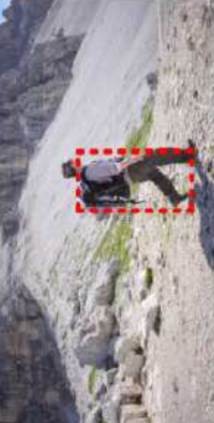
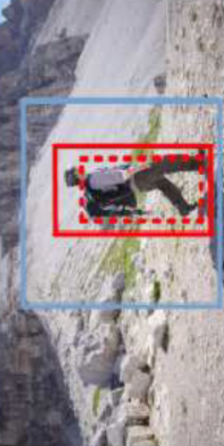
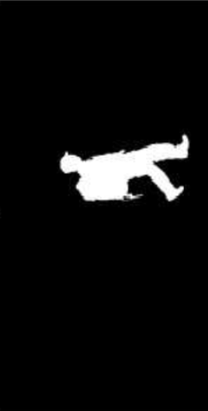
Downsampling => Upsampling
Input Image
Cutting-Policy Network (CPN)
object-context box pair
1box foreground + 1 box object of interest
Cutting-Execution Network (CEN)
generating object masks based on the inferred object-context box pair. It involves learning segmentation-aware representations and discriminative functions to accurately separate the desired foreground object from the background.
Mask
For each frame F_t
30/42

Slide 43
Environnement
Actions : adjustments of bounding box
Input Frame
+
actions history
31/42

Slide 44
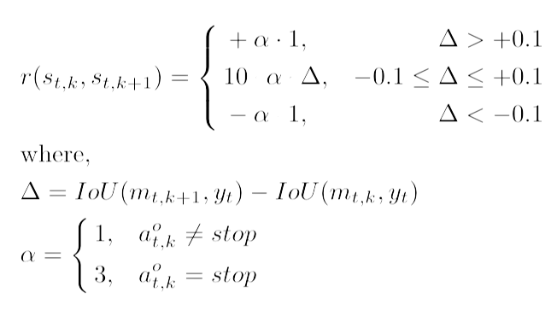
Rewards
Reflects the positive and negative variations of the segmentation mask
32/42

Slide 45
Benchmark vs State-of-the-art (at time)
Improvements
Disadvantages
Best stability through time.
Effective even with motion blur, occlusions, and appearance changes.
Limited Dataset Evaluation.
Segmentation Challenges Not Discussed.
33/42
Notes:
The proposed method consistently outperforms state-of-the-art Video Object Segmentation (VOS) methods on DAVIS and YouTube-Objects datasets.
Improved performance on DAVIS compared to competitive methods, particularly MSK.
Competitiveness with OnAVOS on the DAVIS validation set.
Effective results on YouTube-Objects in terms of mean region similarity (J).
Metrics: Used region similarity (J), counter accuracy (F), and temporal stability (T) for evaluation.
J measures intersection-over-union (IoU) between predicted and ground truth masks.
F assesses the balance between precision and recall.
T accounts for motion and small deformation.
The framework effectively segments objects through interaction with predicted object boxes and context regions.
Demonstrated competitive results, validating its potential use in other computer vision tasks.
Testing:
Evaluated on DAVIS and YouTube-Objects datasets, which contain numerous high-quality videos and frames.
Comparison with existing VOS methods in comprehensive experiments.

Slide 46
05.
Observations and Challenges

Slide 47
Observations
Deep Reinforcement Learning (DRL) has proven its effectiveness in various computer vision applications, from landmark detection to video analysis with competitive results.
It offers promising solutions to complex optimization problems such as parameter tuning and neural architecture search.
Usually faster inference on most tasks.
Does Reinforcement Learning in Computer Vision works ?
34/42

Slide 48
Challenges
Despite its successes, DRL faces significant challenges when applied to real-world computer vision systems.
Defining a precise reward function often requires interdisciplinary knowledge and may not always be feasible.
Handling continuous, high-dimensional state and action spaces remains a challenge, often necessitating discretization.
Real-world environments are rarely stationary, posing challenges for DRL models built on assumptions of stability.
Training DRL agents demands extensive data, which can be scarce in real-world scenarios.
What difficulties are we facing when using it in computer vision ?
35/42

Slide 49
06.
Promising advances

Slide 50
Inverse Deep Reinforcement Learning
Particularly useful in models like the Landmark Detection’s one where reward is very impactful.
Inverse DRL is an approach within Deep Reinforcement Learning.
It differs from traditional DRL by inferring reward functions instead of relying on manually defined ones.
Useful in scenarios like autonomous driving, where creating precise reward functions is challenging.
Inverse DRL uses observed behavior to approximate rewards.
Applied successfully in autonomous driving and complex movement analysis.
Promising for tasks where traditional DRL struggles with reward specification.
Reinforcement Learning
Inverse Reinforcement Learning
Env
Env
Inverse Reinforcement Learning
Rewards
Reinforcement Learning
Behavior
Rewards
Behavior
36/42

Slide 51
Multi-Agent Deep Reinforcement Learning
Used in approaches like the one we have seen for Object Tracking.
Widely used in successful DRL applications, e.g., games, robotics, autonomous driving, stock trading, social science.
Addresses sequential decision-making with multiple autonomous agents, each optimizing its utility.
Complexity arises from non-stationarity, multi-dimensionality, and credit assignment.
Agents can cooperate for long-term gain or compete for a total utility of zero.
Recent research focuses on developing new criteria and setups for Multi-Agent RL.
Agent 1
Agent 2
Join State
Actions
Env
Agent 3
Agent 4
37/42

Slide 52
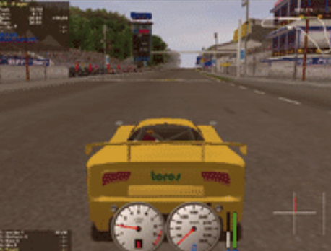
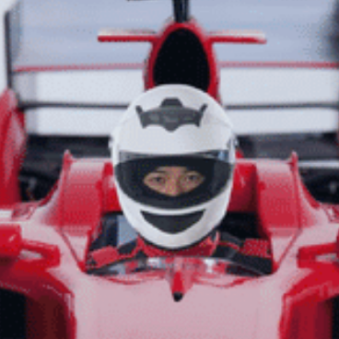

Imitation Learning
Imitation learning is akin to learning from demonstrations.
It trains a policy to replicate expert behavior using samples from the expert.
An alternative to RL/DRL for solving sequential decision-making problems.
Behavior cloning, a form of imitation learning, trains policies through supervised learning.
Notable methods include third-person imitation learning and behavior cloning Loss.
Generative Adversarial Imitation Learning (GAIL) integrates imitation learning into policy gradient frameworks, considering smoothness and causal entropy.
Training Data
Demonstrations
Human Experience
Reinforcement Learning
State
Observation
Imitation Learning
Reward
Perception
Agent Playing Image
Human Expert
Action
Action
38/42

Slide 53
Reinforcement Learning from human-feedback
RLHF (Reinforcement Learning from Human Feedback) trains AI agents through human interaction and feedback.
It's ideal for tasks like customer service, negotiation, and creative writing where explicit rules are hard to define.
RLHF uses a "reward model" to predict the quality of agent outputs and enhance RL agent exploration.
Applications include Natural Language Processing tasks like conversational agents and text summarization.
Challenges include scalability issues, potential undesirable behaviors, overfitting risks, and manipulation concerns.
Would be particularly useful for edge cases in computer vision.
Prompts dataset
………………………………………….
………………………………………….
………………………………………….
………………………………………….
Train on (sample, reward) pairs
Reward preference model
Sampling prompts
………………………………………….
Human Scoring
Initial Language Model
Generated Text
Ranked outputs
39/42

Slide 54
Meta Deep Reinforcement Learning
Traditional DRL relies on extensive experience for task learning but struggles to generalize to new problems.
Meta-RL addresses this by enabling agents to acquire new skills from limited experience.
Growing interest in meta RL with various approaches explored.
For benchmarking and evaluation, Meta-world offers an open-source simulator with 50 distinct robotic manipulation tasks.
Env
Env
Actions
Env
Join State
Agent 1
Env
Env
Env
Distribution of environnements
40/42

Slide 55
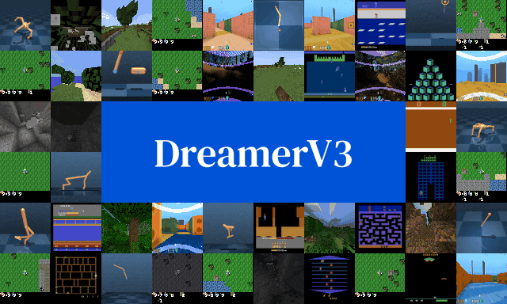
World Models : DreamerV3
https://danijar.com/project/dreamerv3/
DreamerV3 is a reinforcement learning algorithm based on world models.
It outperforms previous methods in a wide range of domains with fixed hyperparameters.
Domains include continuous/discrete actions, visual/low-dimensional inputs, 2D/3D worlds, and different data budgets, reward frequencies, and scales.
DreamerV3 is the first algorithm to collect diamonds in Minecraft from scratch without human data (no imitation learning).
It reduces the need for extensive tuning, making reinforcement learning more broadly applicable.
41/42
17/26

Slide 56
Conclusion
Reinforcement Learning looks like a viable way to approach computer vision.
Already multiple papers and approaches successfully implementing it
Lot of challenges in terms of modeling and architecture.
Advantages in terms of speed and interpretability which are needed to be studied
42/42
17/26

Slide 57

Thank you !
Questions Time

Slide 58
References
Active Object Localization with Deep Reinforcement Learning.
Reinforcement Cutting Agent Learning.
Robust multimodal image registration using deep recurrent reinforcement learning.
Seednet: Automatic seed generation with deep reinforcement learning for robust interactive segmentation.
Multi-agent deep reinforcement learning for multi-object tracker.
Multi-scale deep reinforcement learning for real-time 3d-landmark detection in ct scans.

Slide 59
2 Types of RL algorithms : Model-based & Model-free
Model-Based
Model-Free
These models are used for simulating possible scenarios, planning, and optimizing actions.
It directly learns optimal policies or value functions through trial and error.
Model-based methods aim to learn a representation of how the environment behaves.
Model-free methods focus on interacting with the environment and improving decision-making without building a detailed model.
Model
Model Building
Planning
Model based approach
Experience
Value Function
Policy
Model free approach
3/42
17/26

